Slide 1
MaxBox
24cm
20cm

Slide 2
Which gives a box that looks like this

Slide 3
When we cut out a 5cm square we get this box.

Slide 4
What happens if we cut out a smaller square?

Slide 5
What happens if we cut out a larger square?
Which box has the largest volume?

Slide 6
MaxBox
24cm
5cm
20cm

Slide 7
MaxBox
24cm
Height = ?
20cm

Slide 8
MaxBox
24cm
Height = 5
20cm

Slide 9
MaxBox
24cm
Height = 5
Length = ?
20cm

Slide 10
MaxBox
24cm
Height = 5
5
Length = 14
5
20cm

Slide 11
MaxBox
24cm
Height = 5
Length = 14
Width = ?
20cm

Slide 12
MaxBox
24cm
5
Height = 5
Length = 14
Width = 10
20cm
5

Slide 13
Volume of this box
Volume = length x width x height
Volume = 14 x 10 x 5 = 700 cm³

Slide 14
Find the largest box you can make if you start with a piece of card
30 cm by 20 cm
25 cm by 25 cm
Other sizes …

Slide 15
Possible Approaches?
Cut out a different sized square
4cm or 6cm
By making the models
Without making the models - explain
Use the graph to estimate maximum
Use decimals
Use a spreadsheet
2 Extension Ideas follow

Slide 16
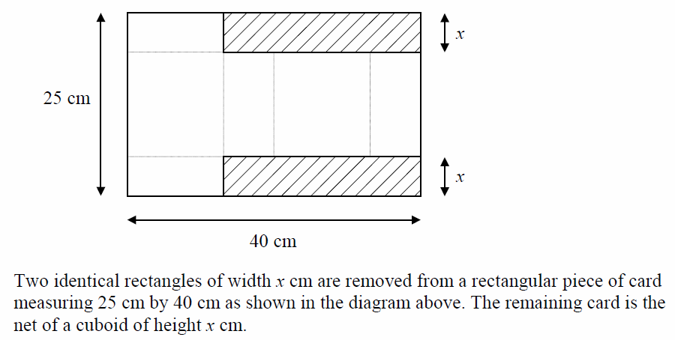
Maximise the volume of this cuboid
Extension Task 1

Slide 17
If the largest volume for a piece of card
which is 20cm by 20cm is 592.6 cm³
What is the largest volume for a
piece of card which is:
40 cm by 40 cm?
10 cm by 10 cm?
40 cm by 20 cm?
Extension Task 2

